Slide 1
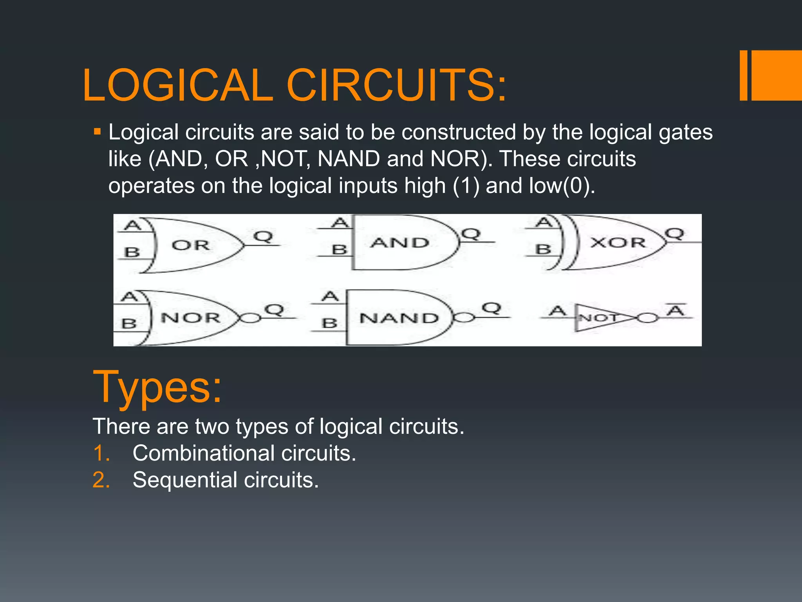

Slide 2
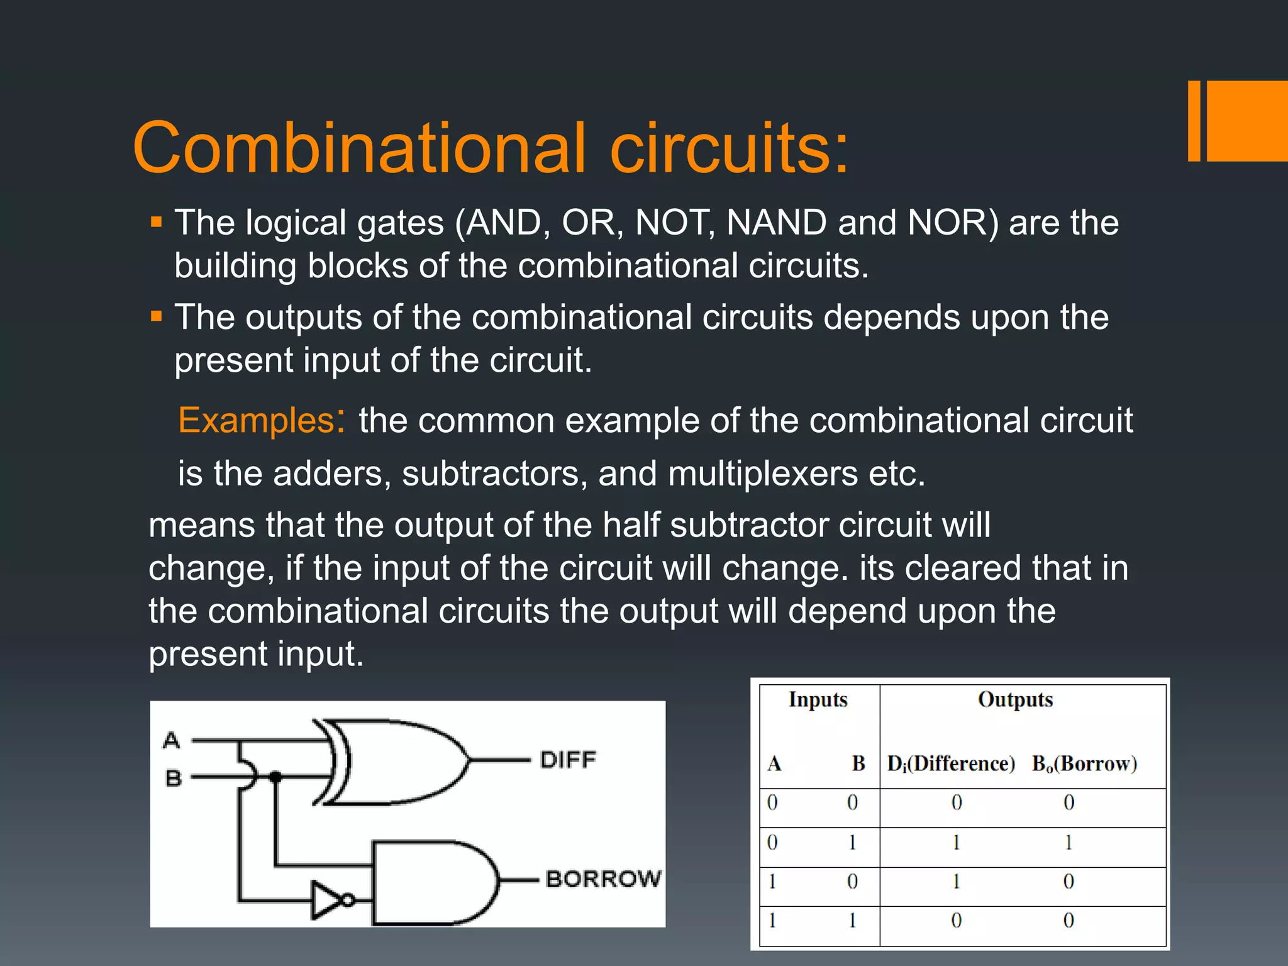

Slide 3
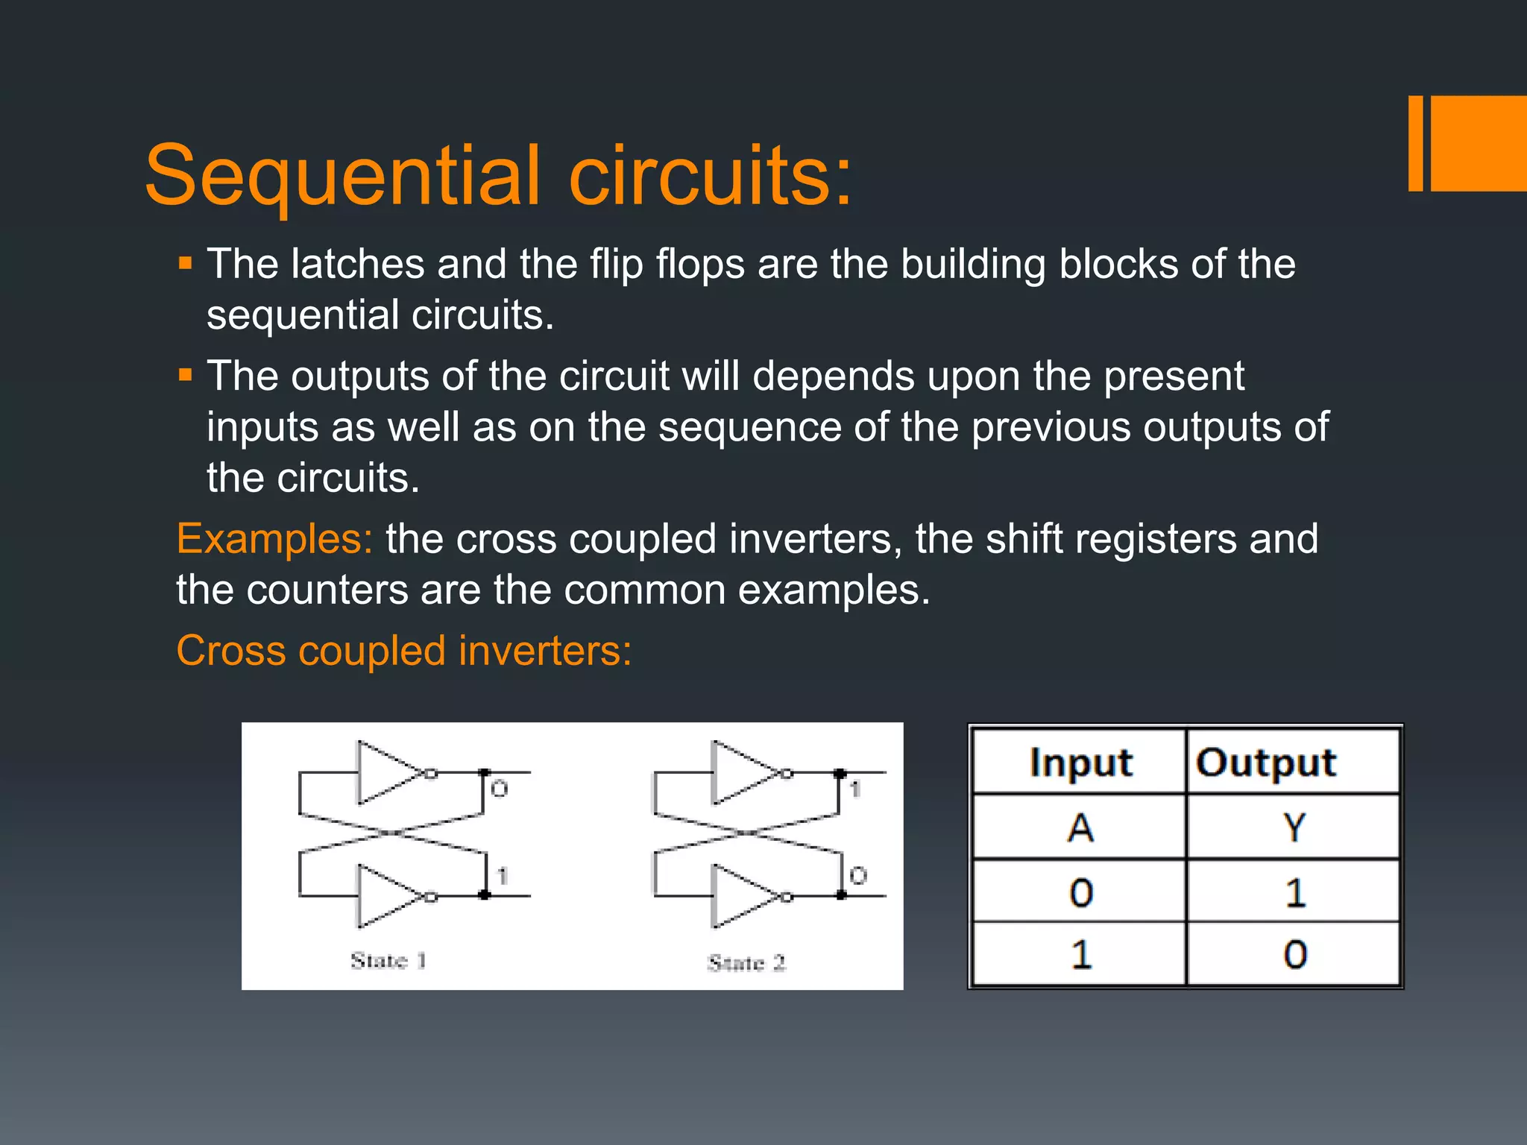

Slide 4
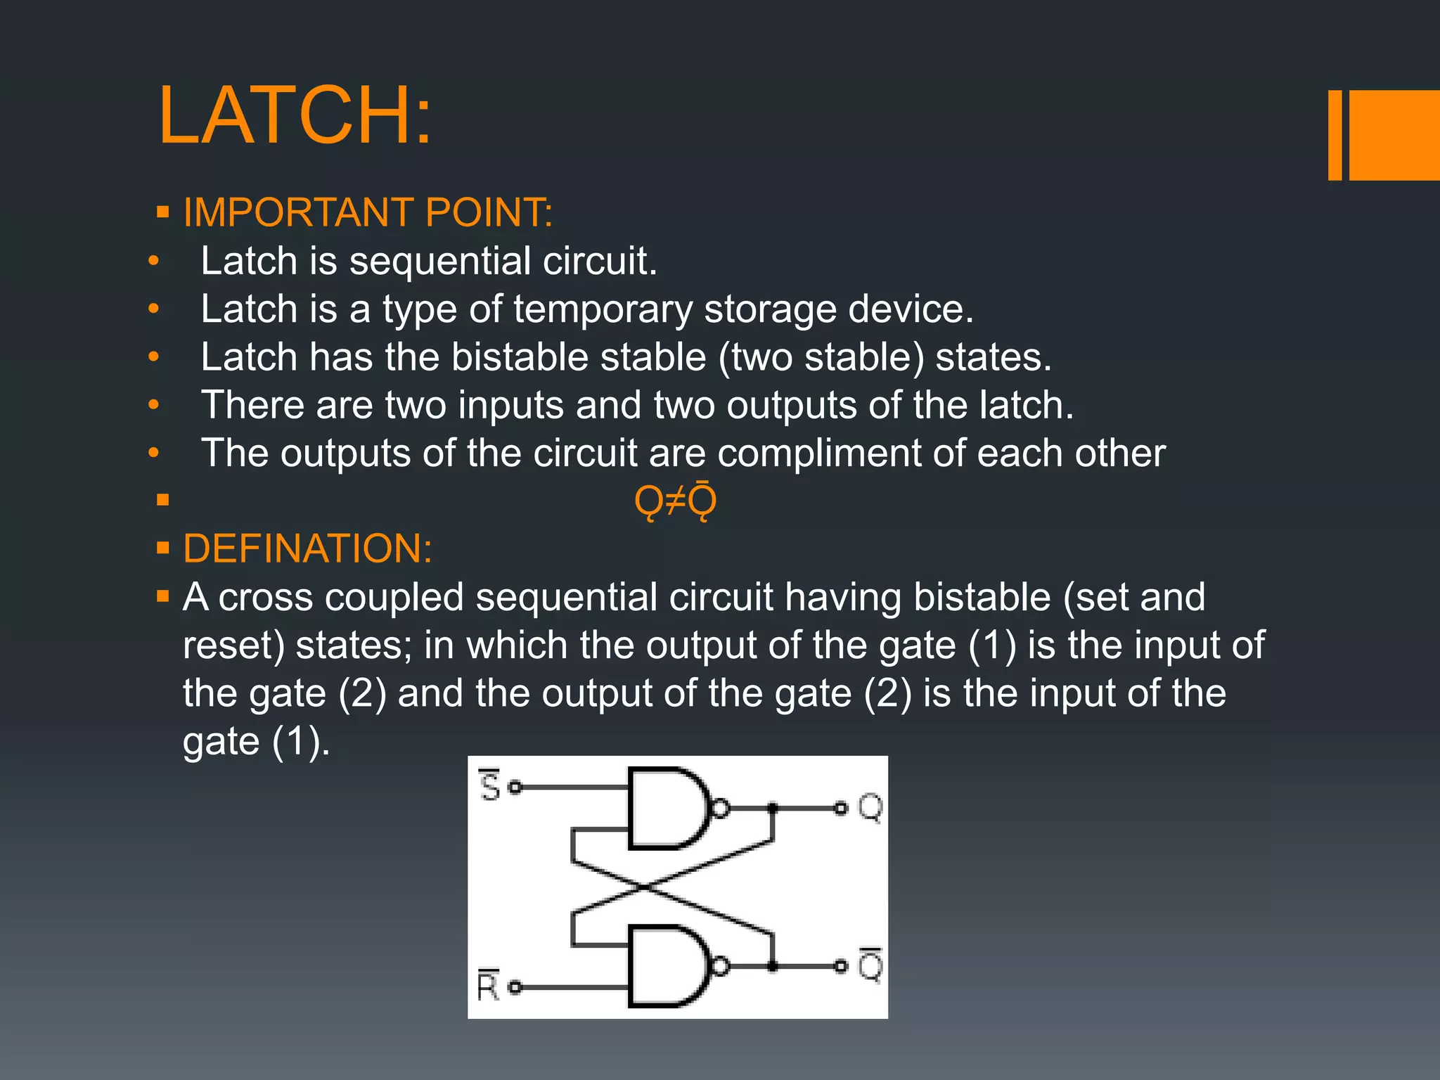

Slide 5
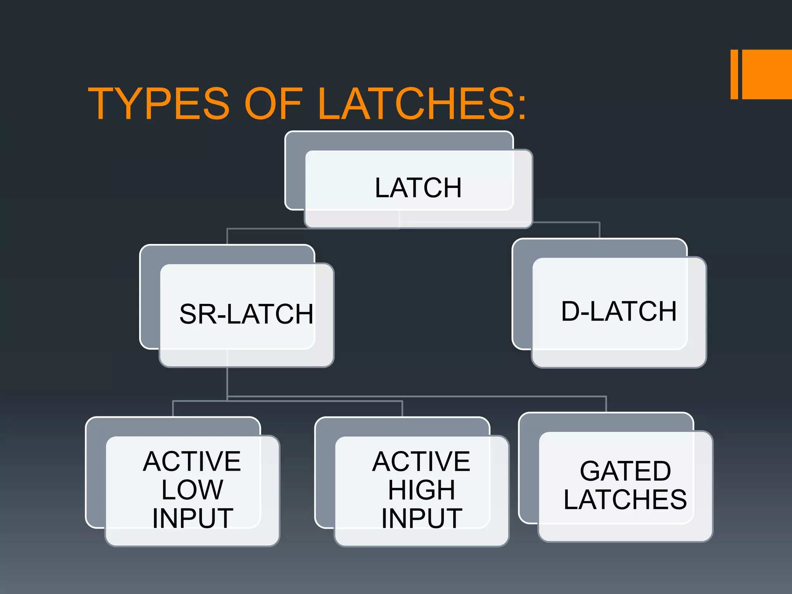

Slide 6
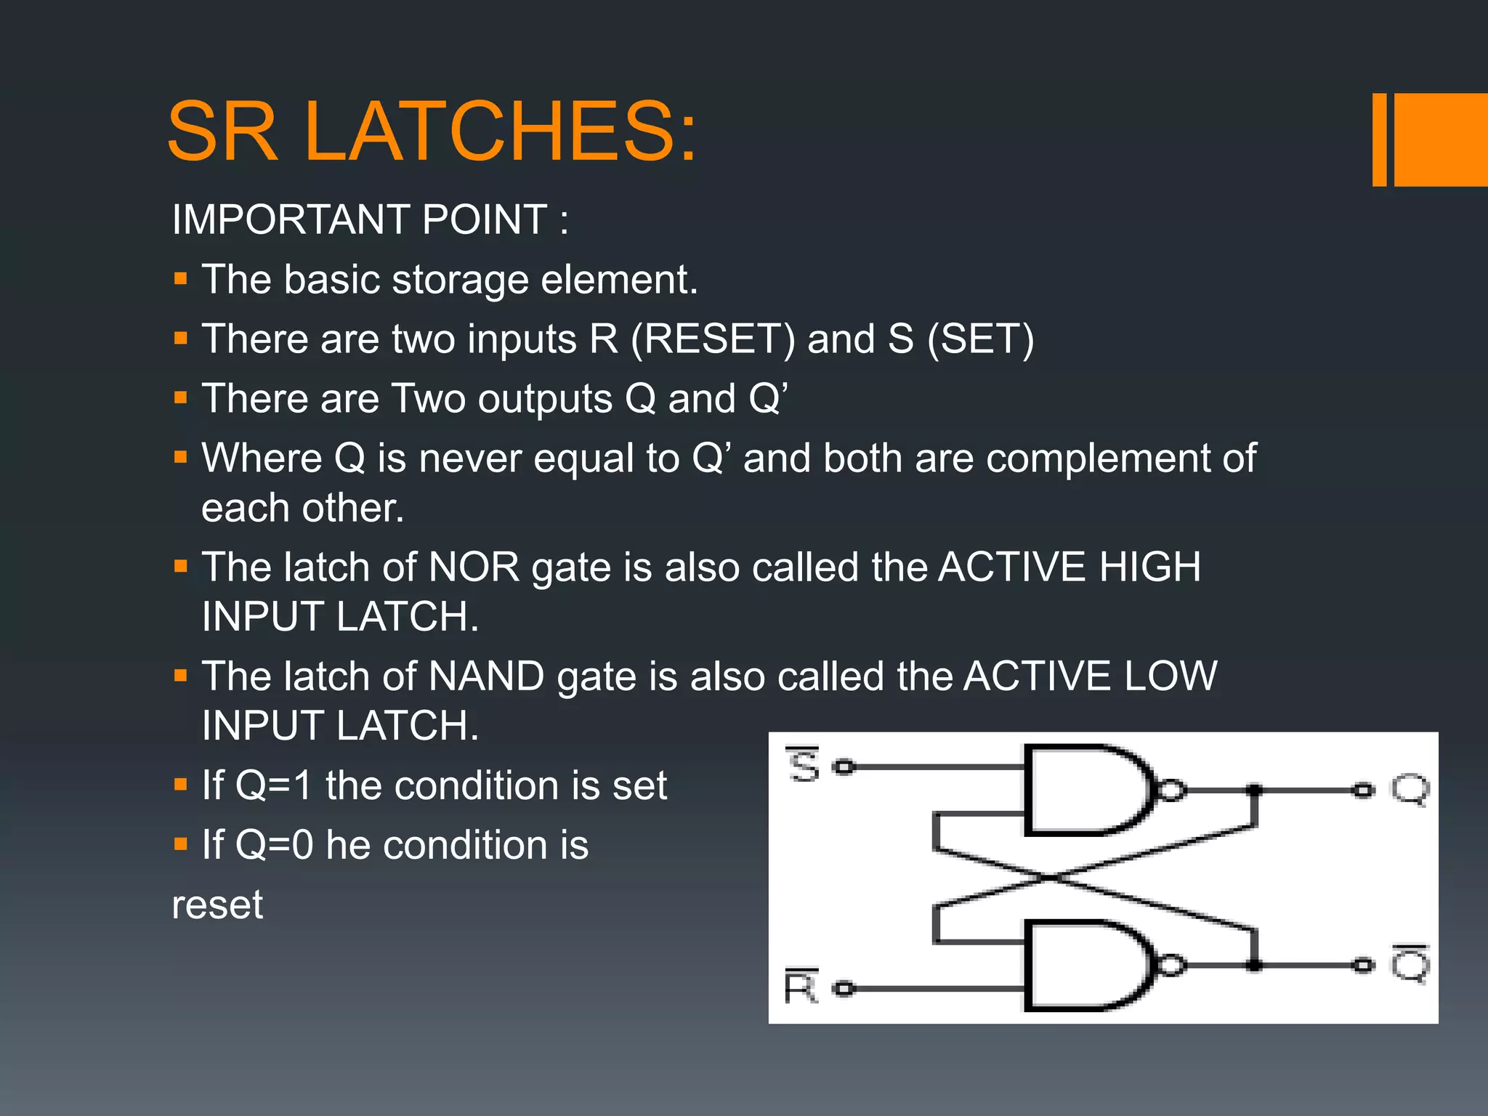

Slide 7
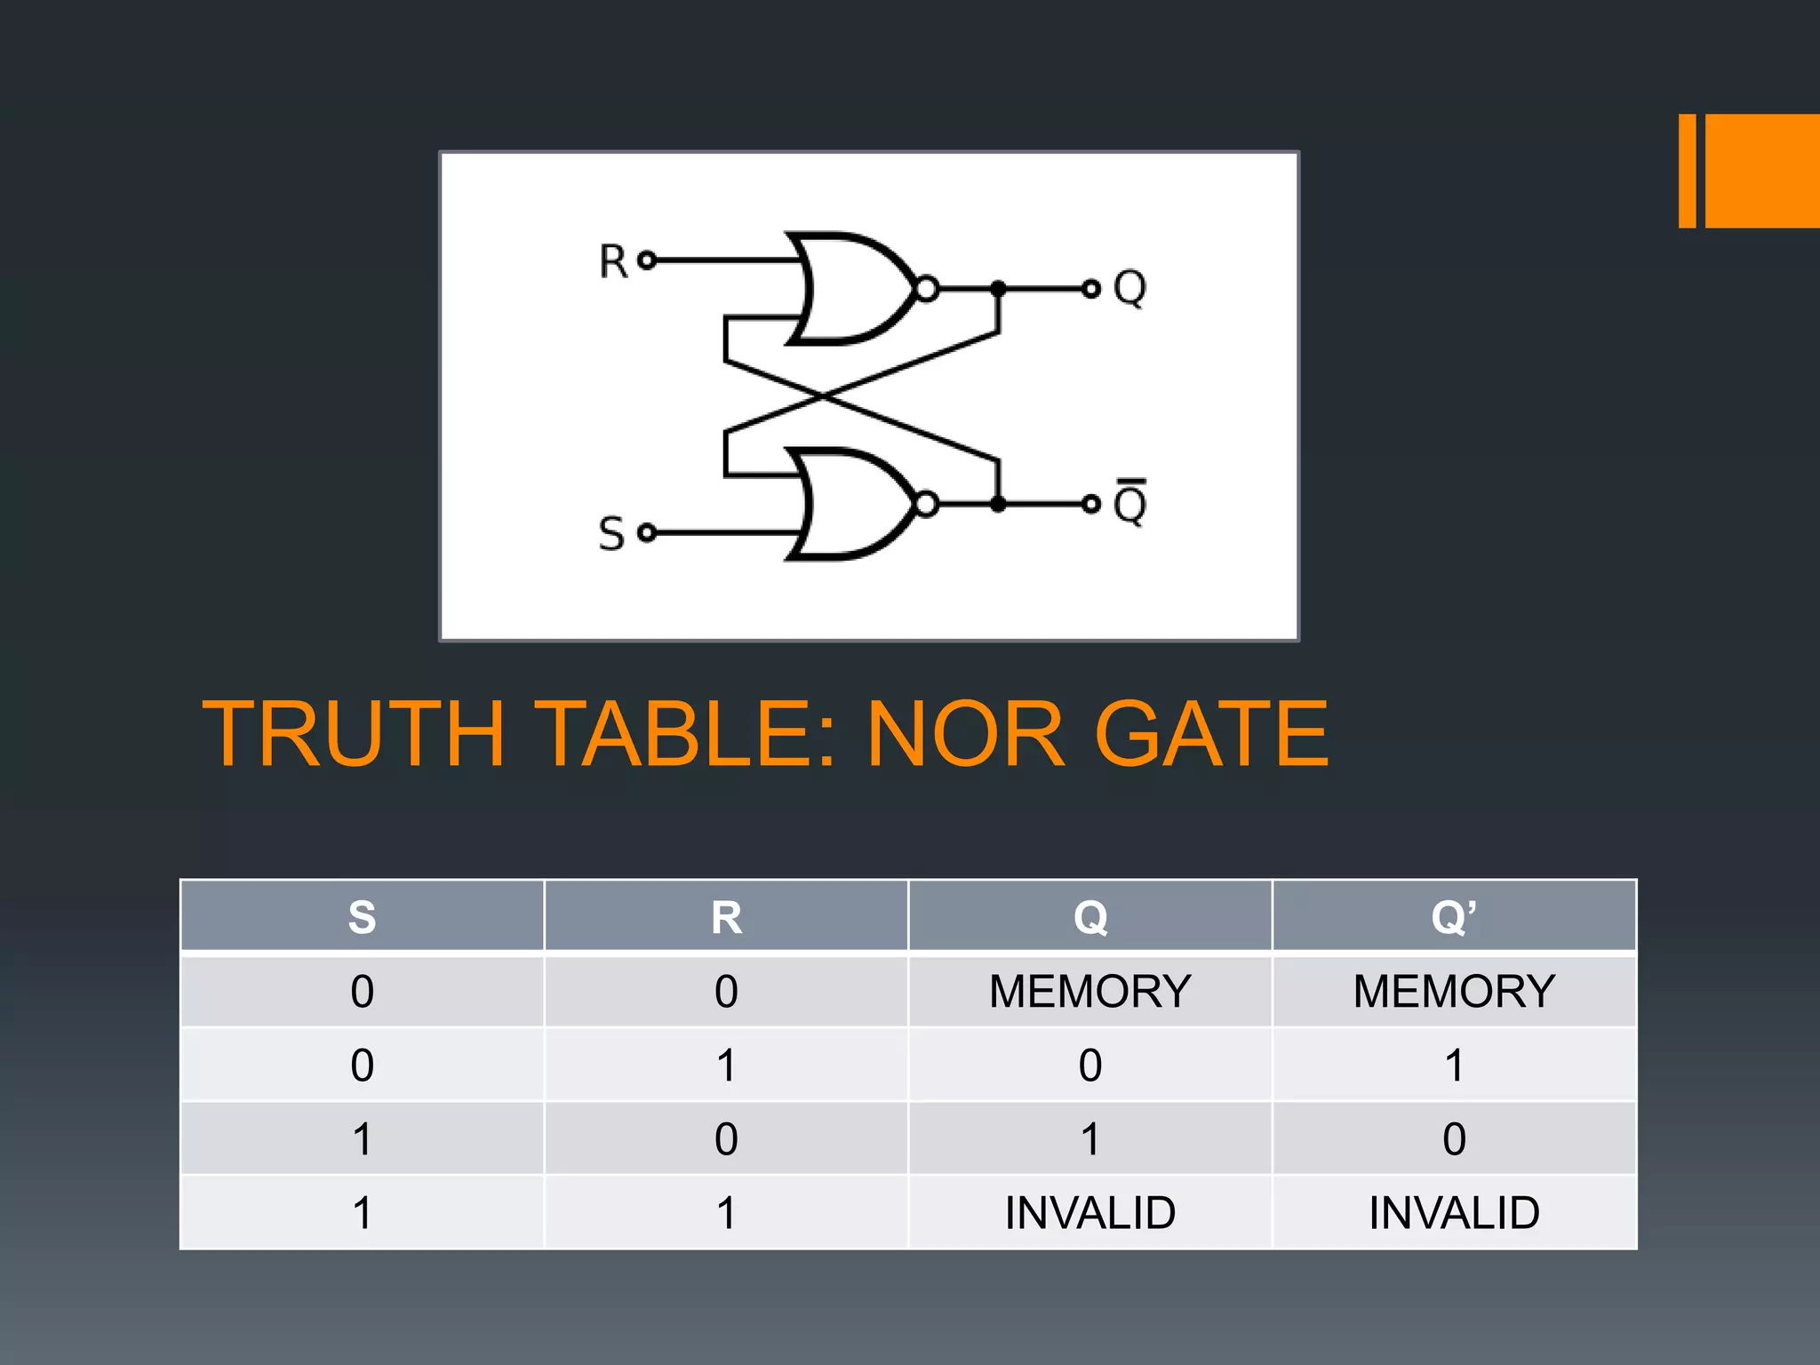

Slide 8
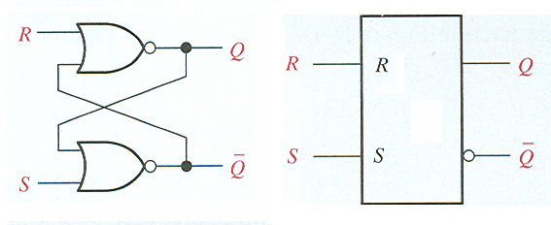
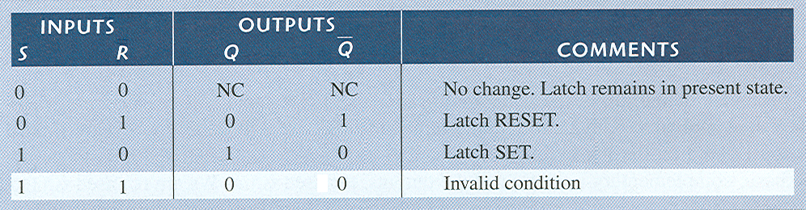
Latches
S-R latch

Slide 9
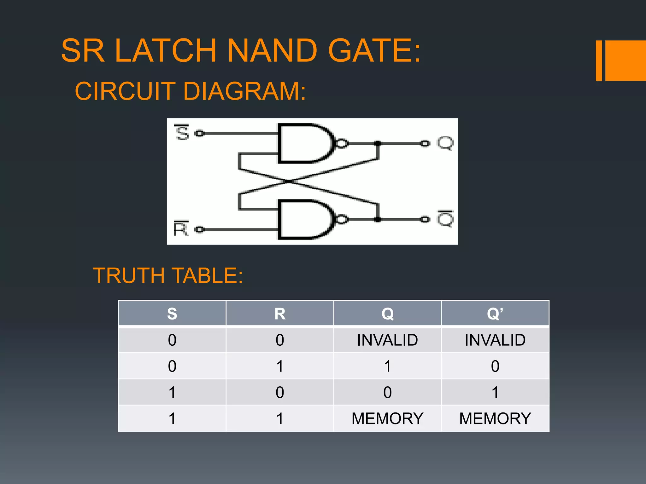

Slide 10
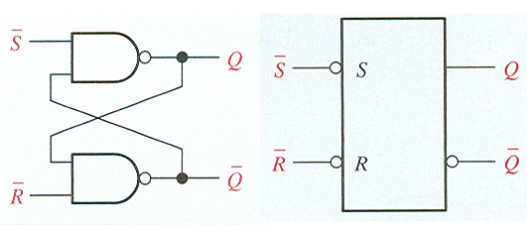
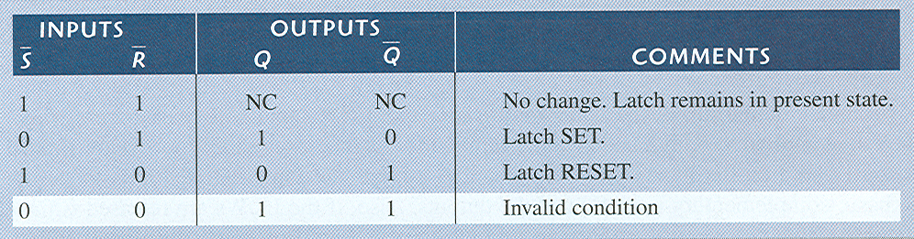
Latches
S-R latch

Slide 11
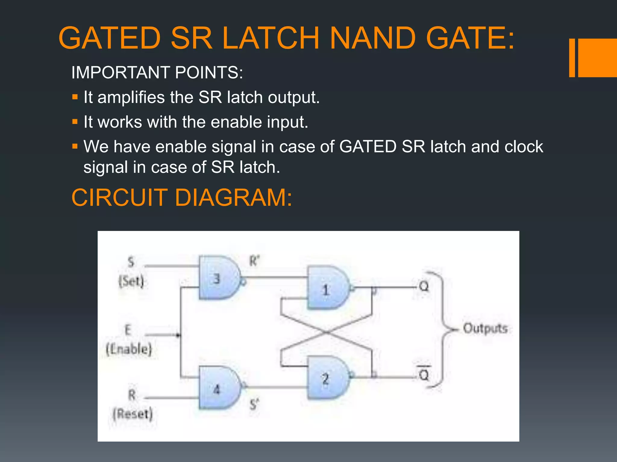

Slide 12
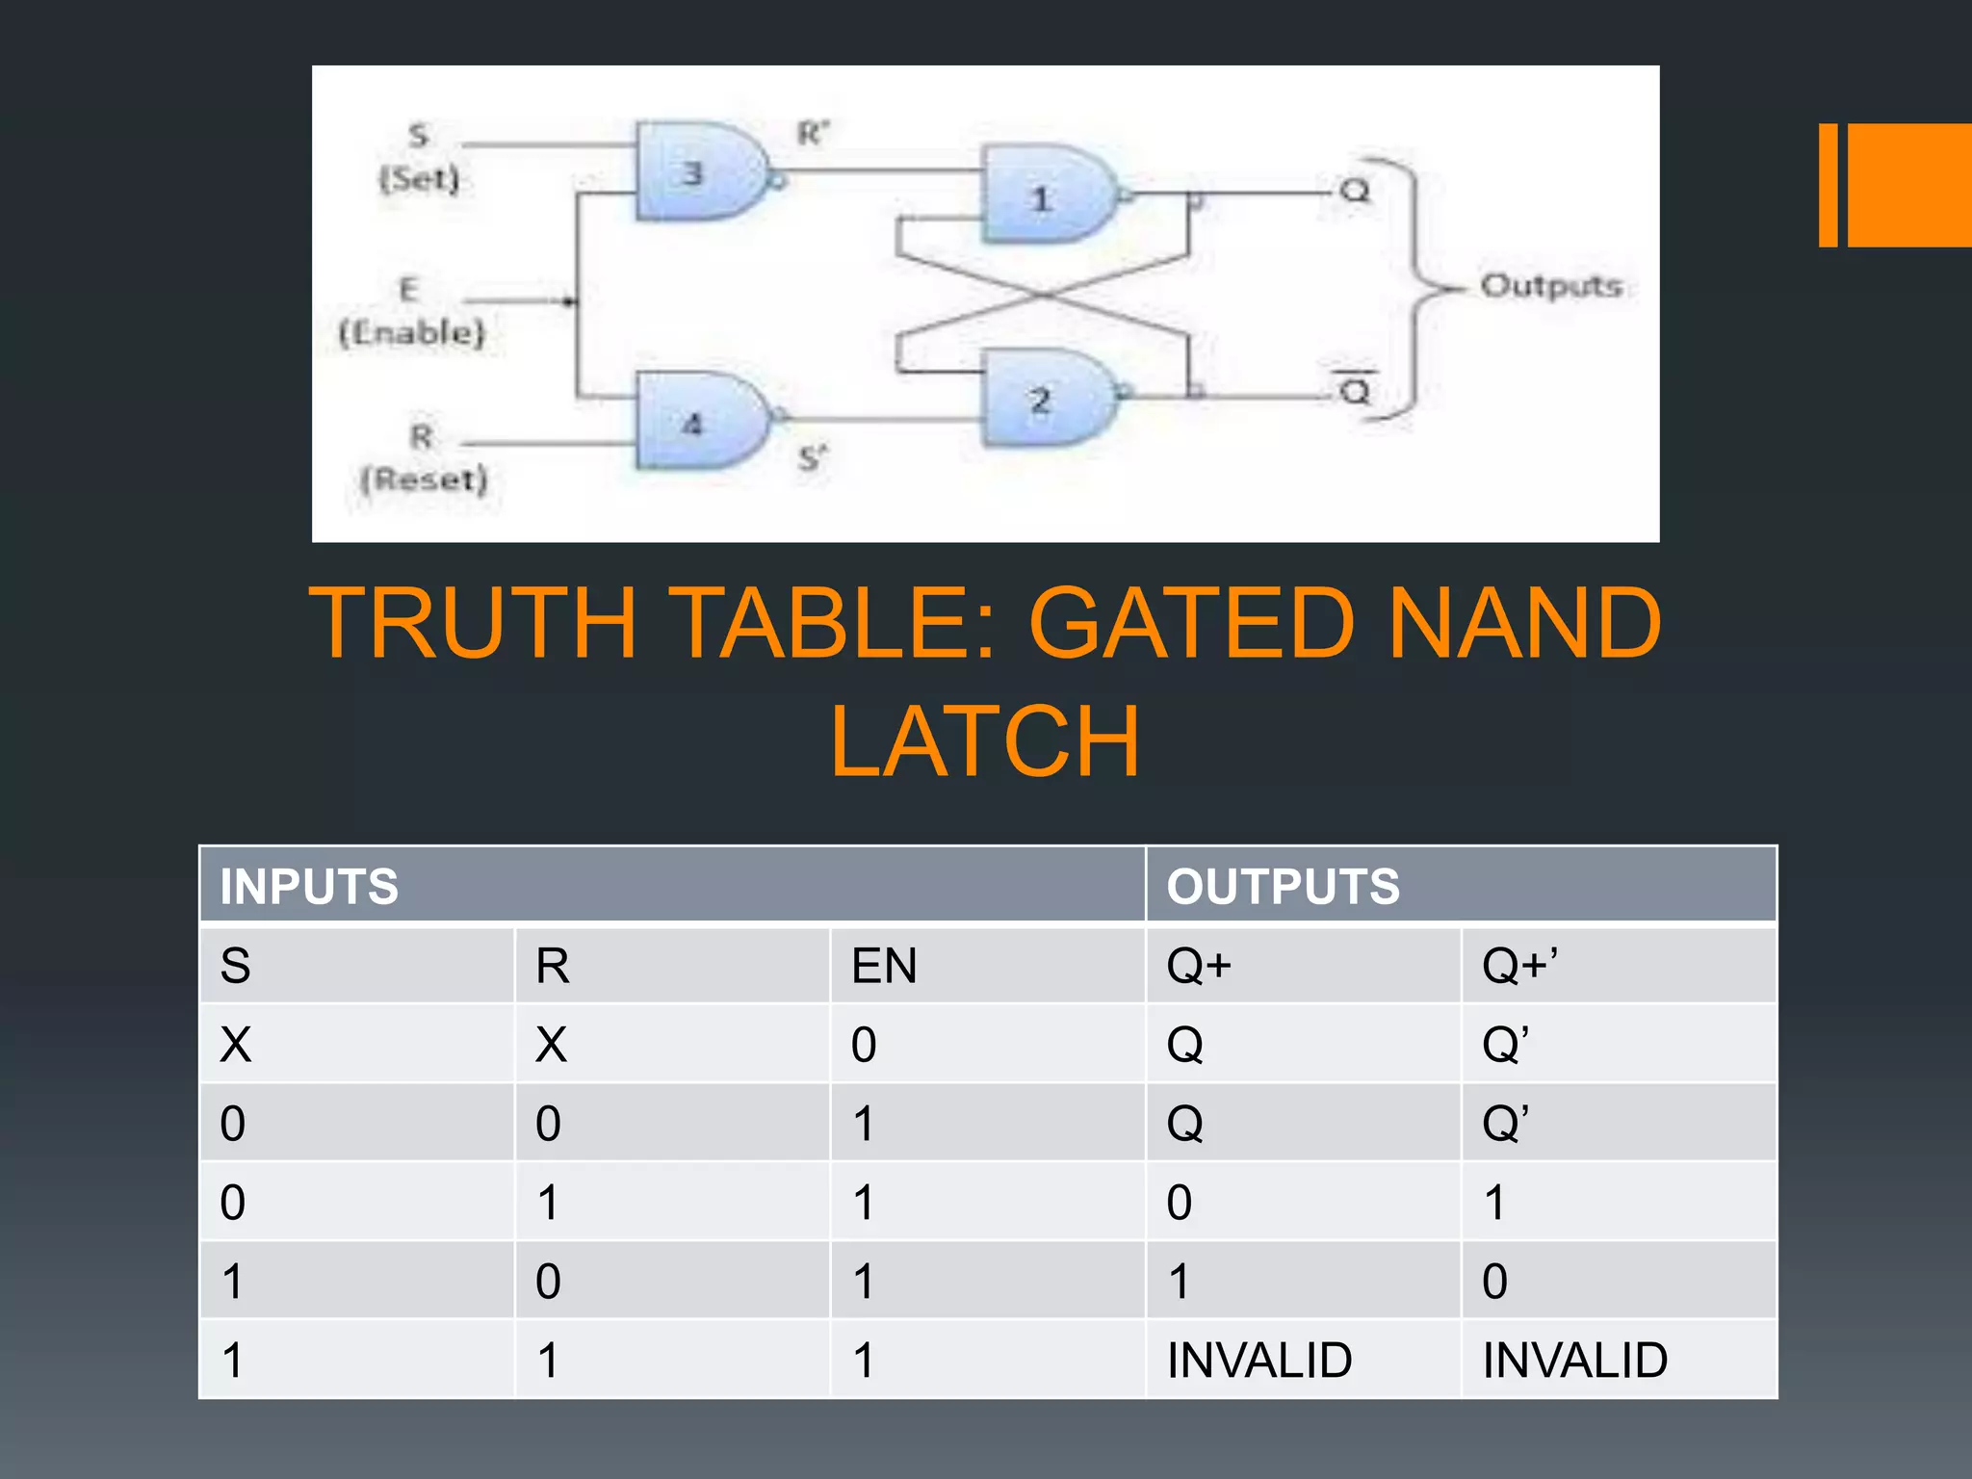

Slide 13
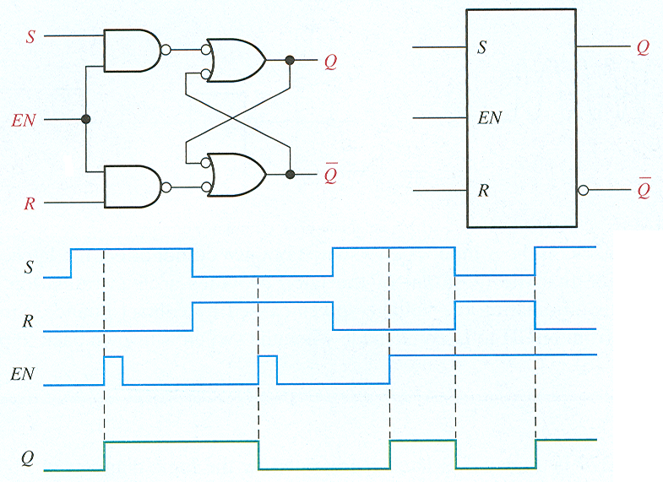
Latches
Gated S-R latch

Slide 14
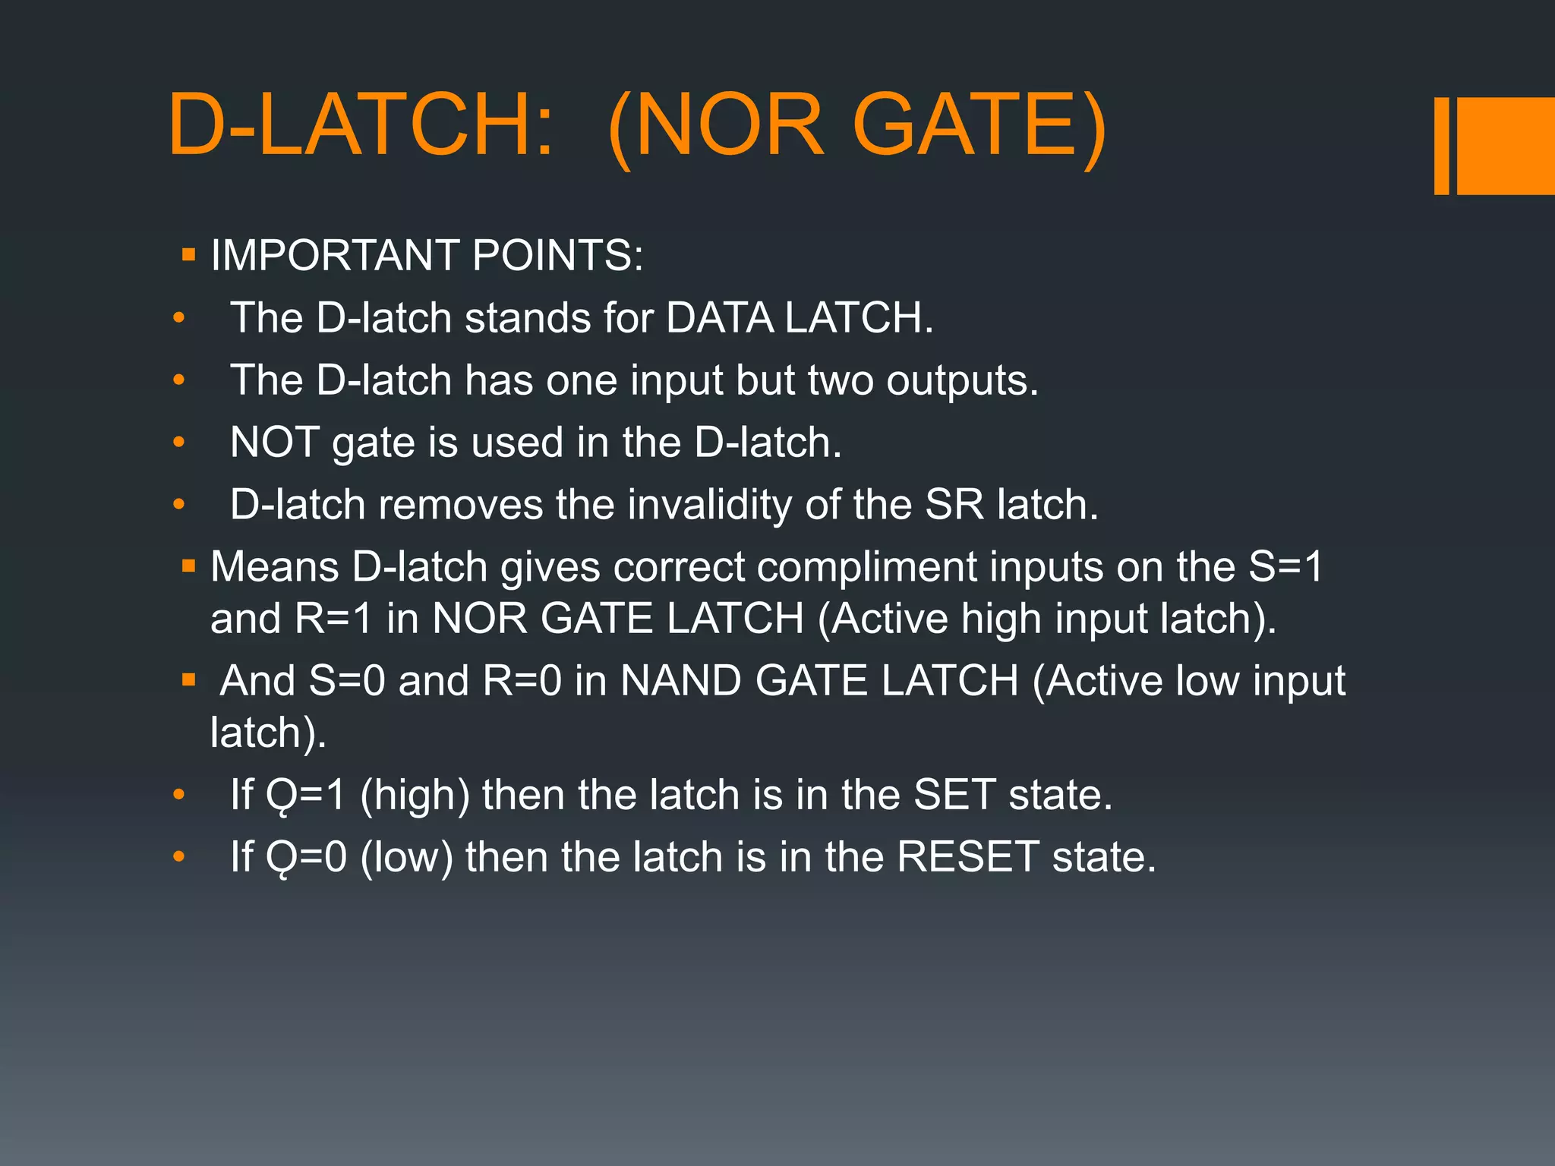

Slide 15
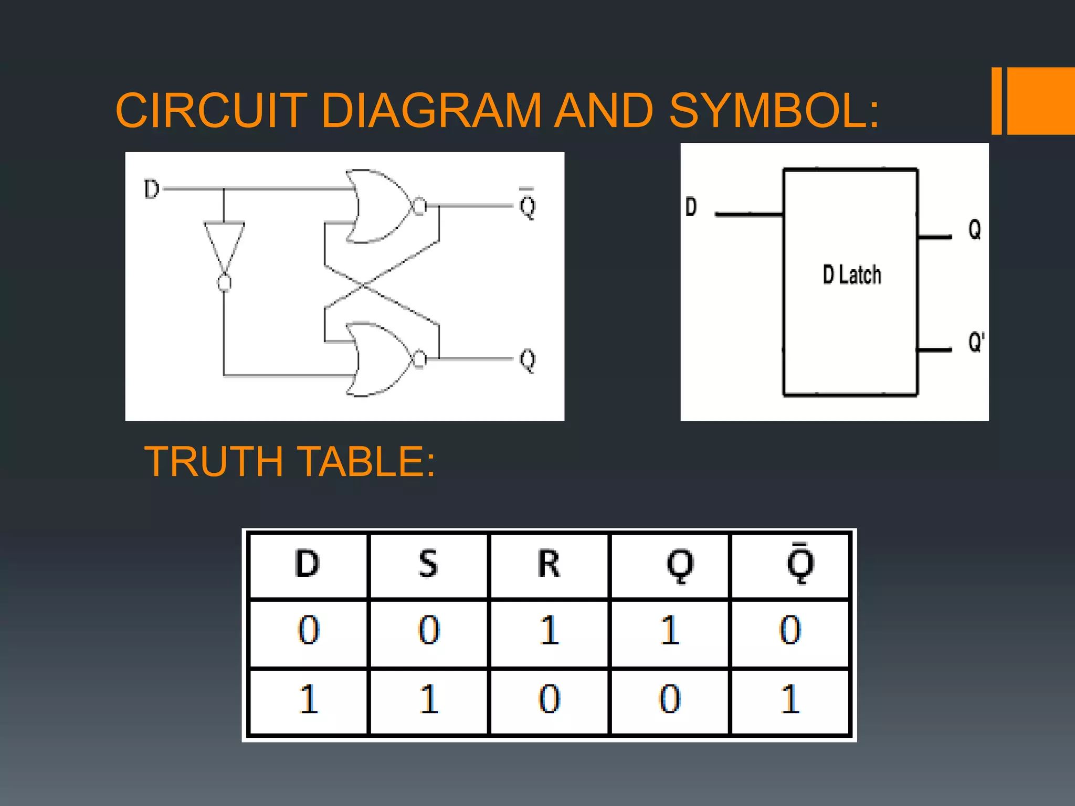

Slide 16
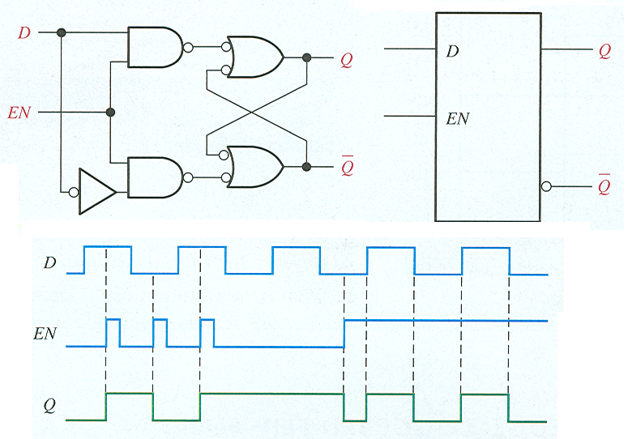
Latches
Gated D latch

Slide 17
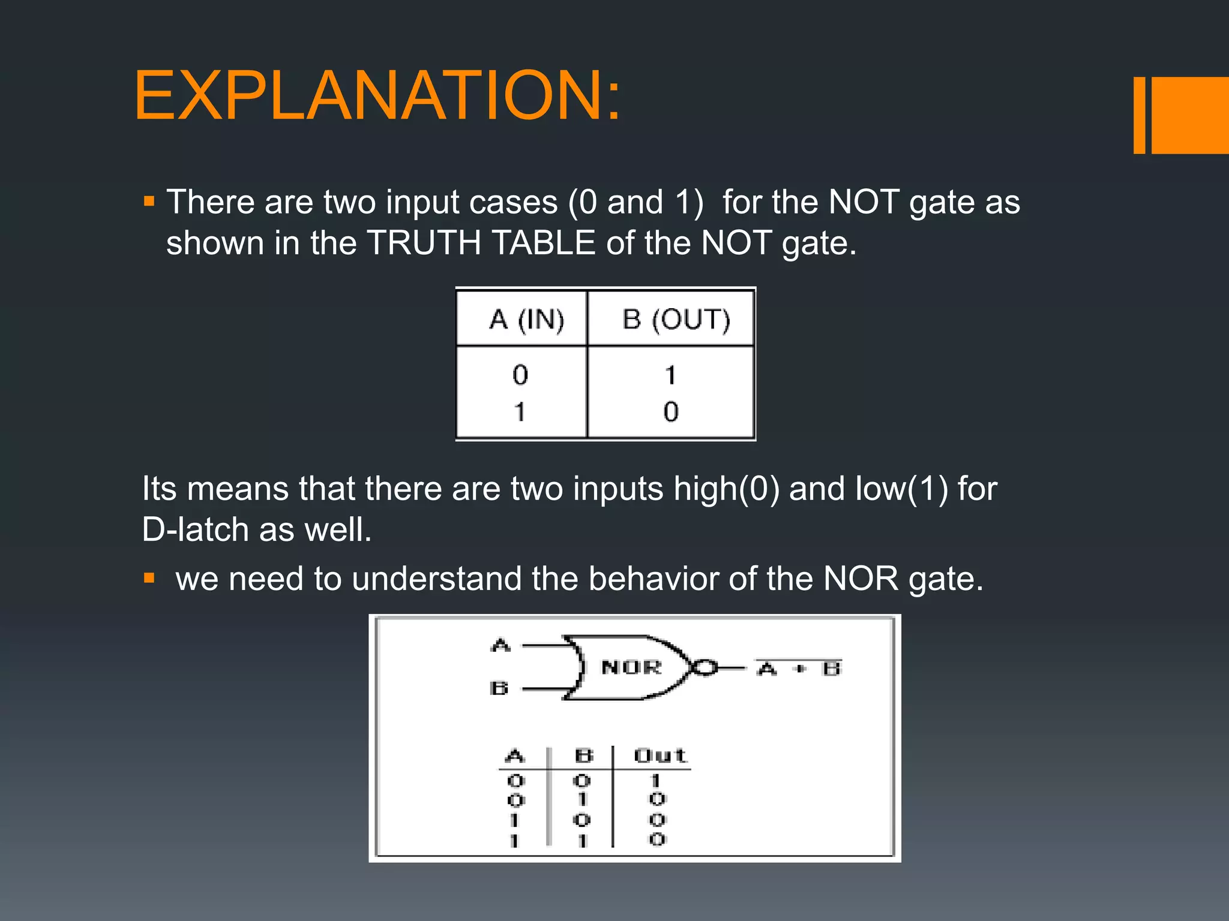

Slide 18
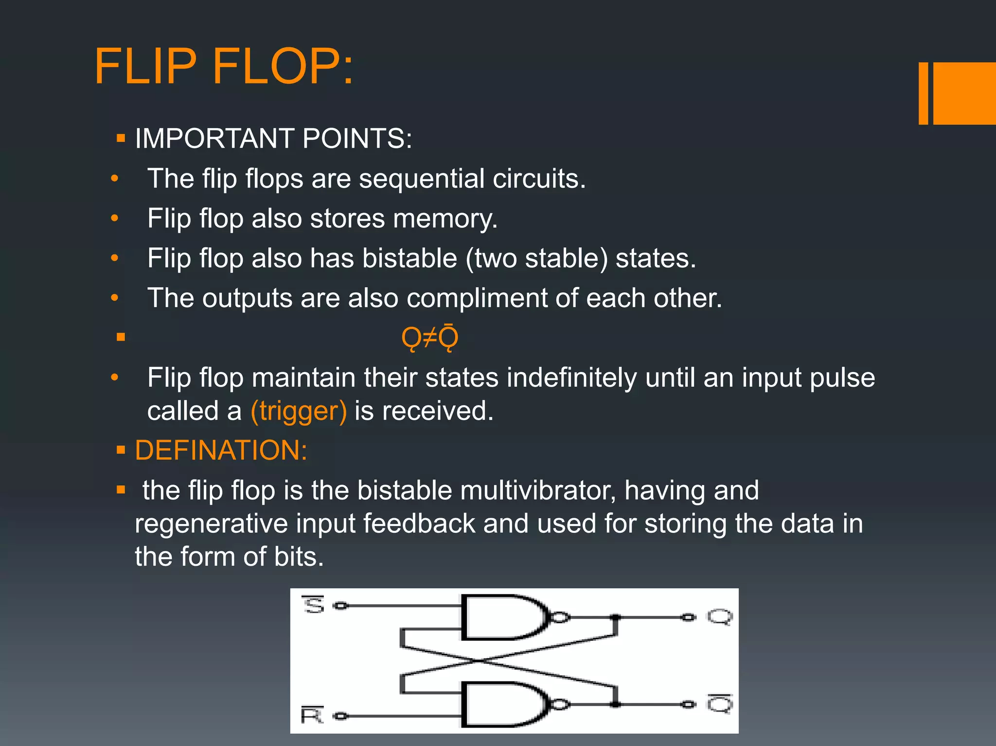

Slide 19
Flip-flops
A flip-flop differs from a latch in the manner it changes states. A flip-flop is a clocked device, in which only the clock edge determines when a new bit is entered.
The active edge can be positive or negative.
Dynamic input indicator

Slide 20
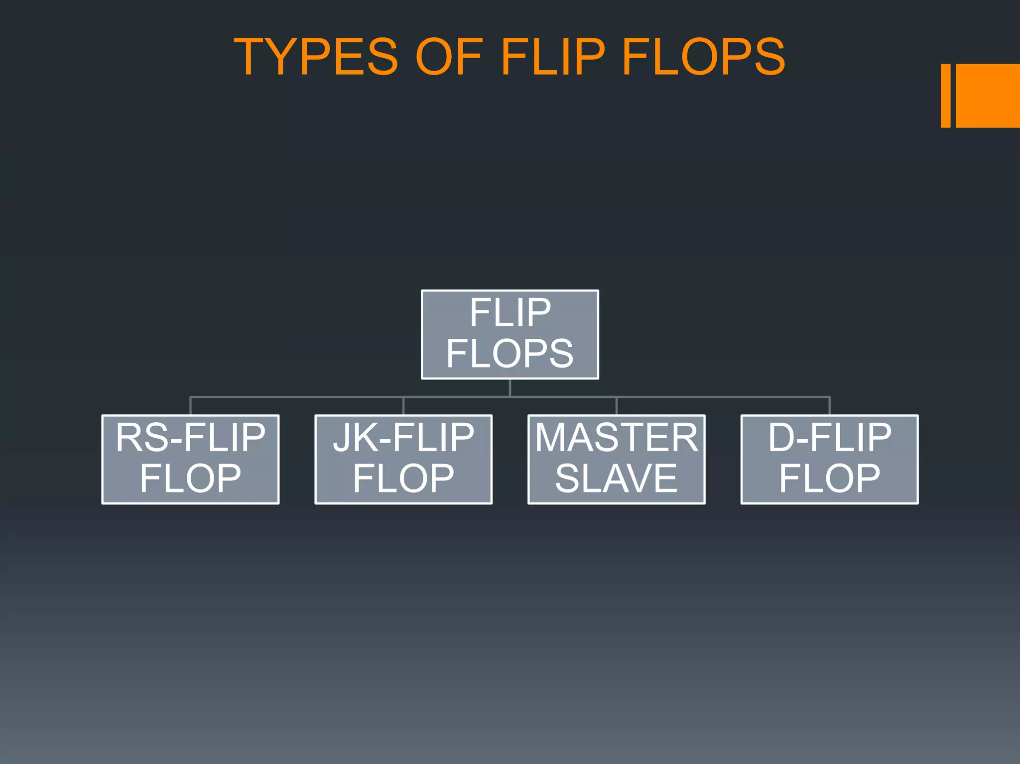

Slide 21
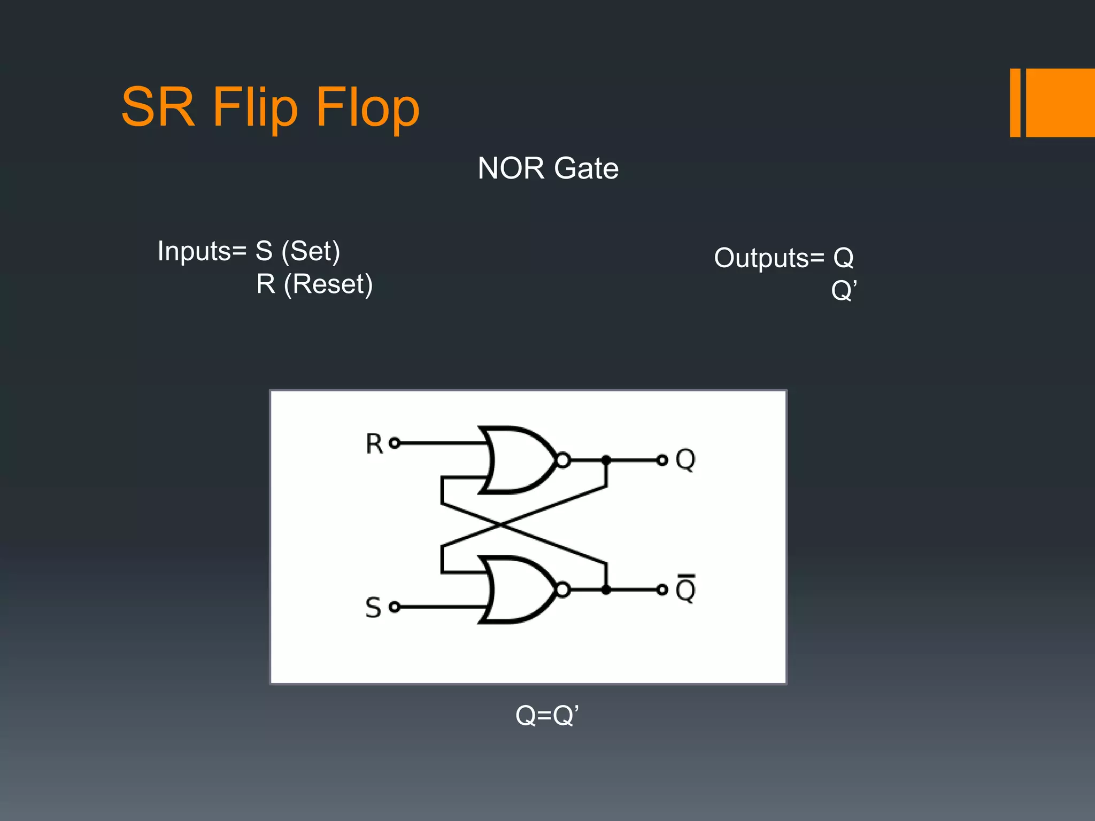

Slide 22
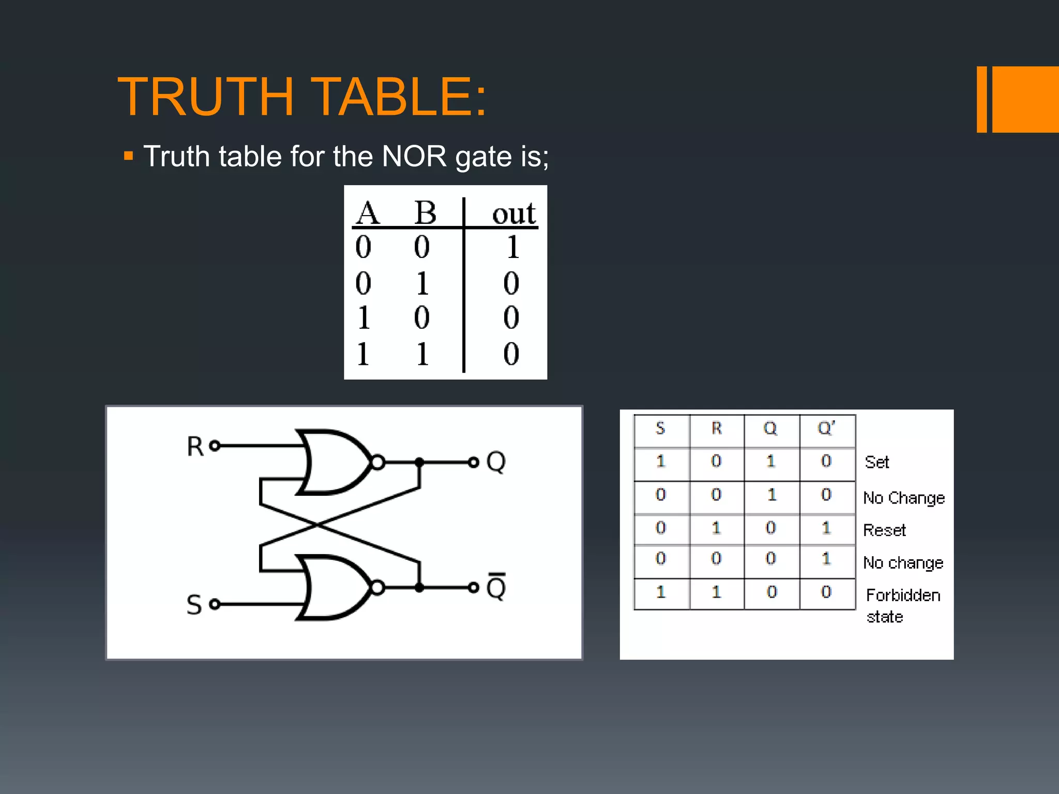

Slide 23
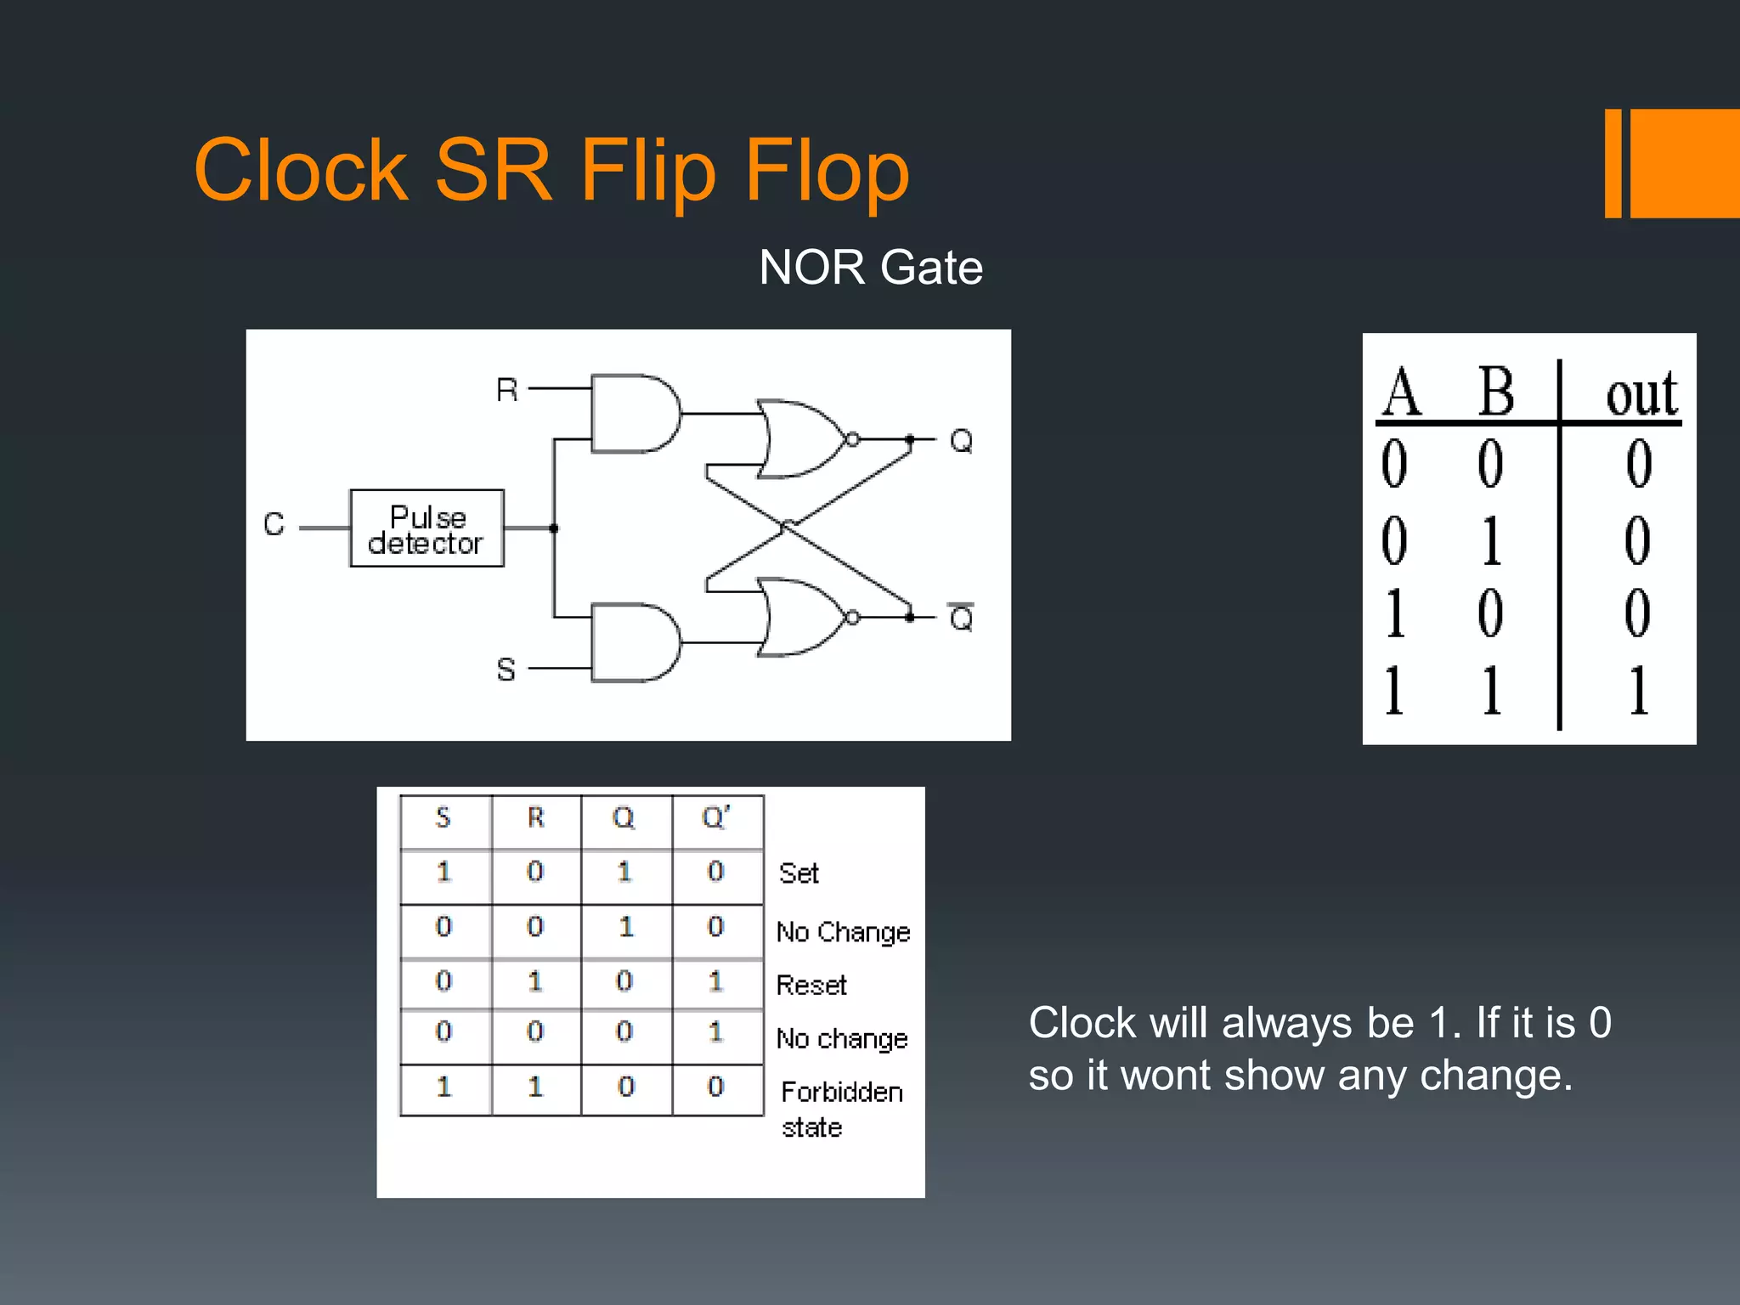

Slide 24
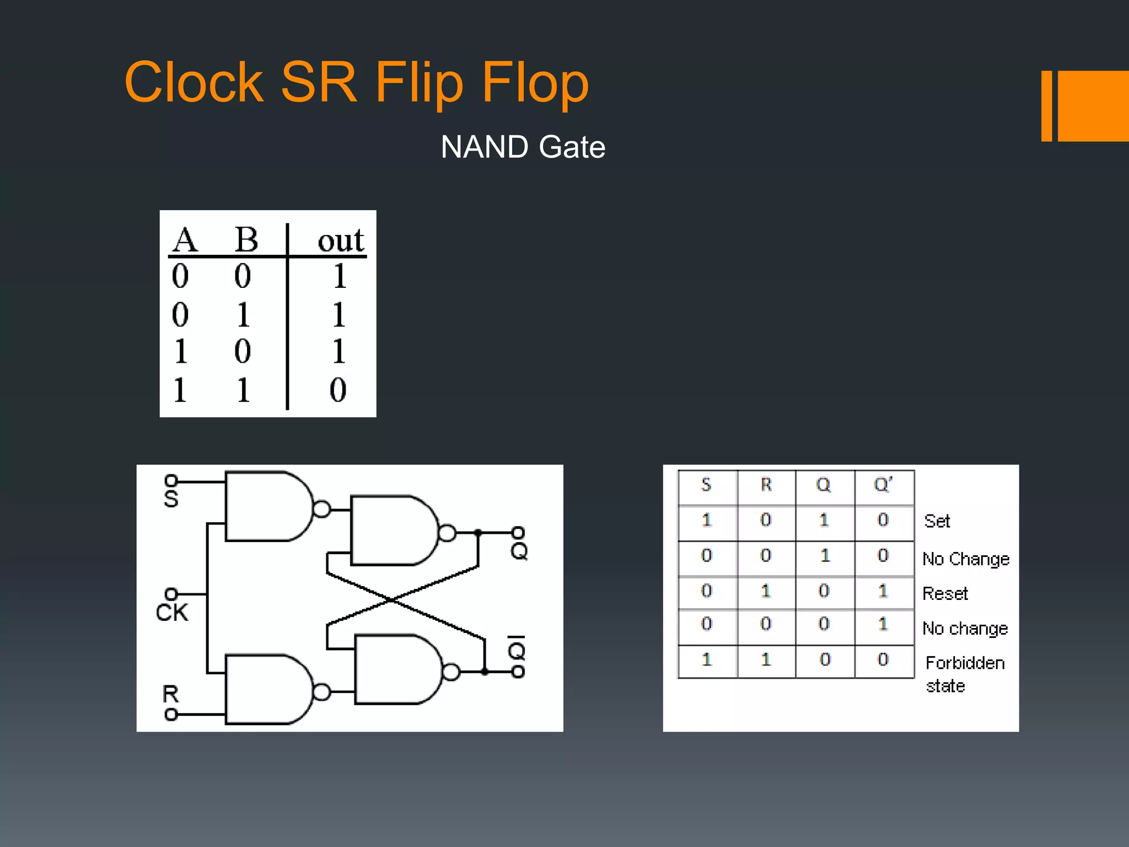

Slide 25
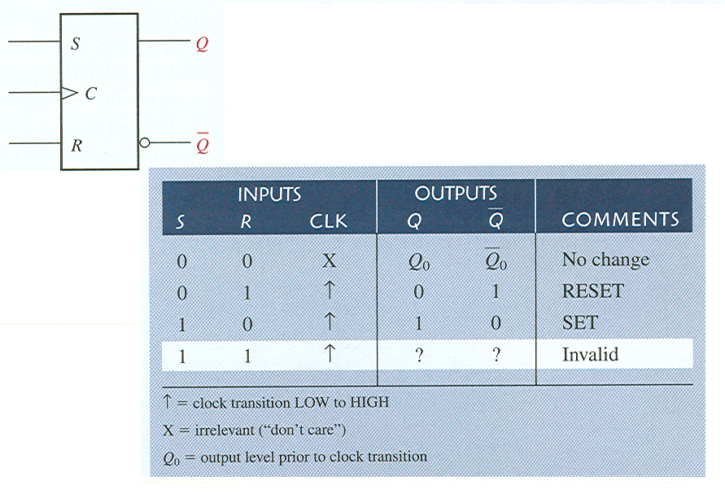
Edge-Triggered Flip-Flops
Edge-triggered S-R flip-flop
Waveforms

Slide 26
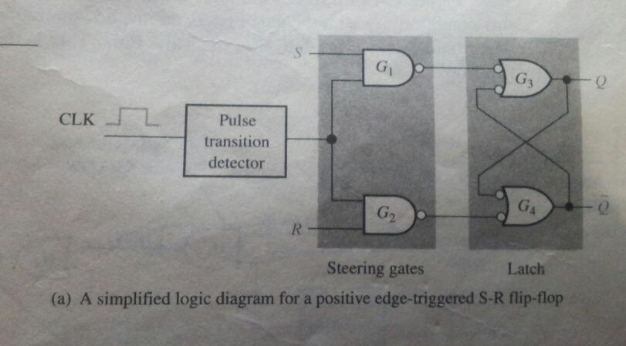

Slide 27
Flip-flops
The truth table for a positive-edge triggered D flip-flop shows an up arrow to remind you that it is sensitive to its D input only on the rising edge of the clock; otherwise it is latched. The truth table for a negative-edge triggered D flip-flop is identical except for the direction of the arrow.
(a) Positive-edge triggered (b) Negative-edge triggered

Slide 28
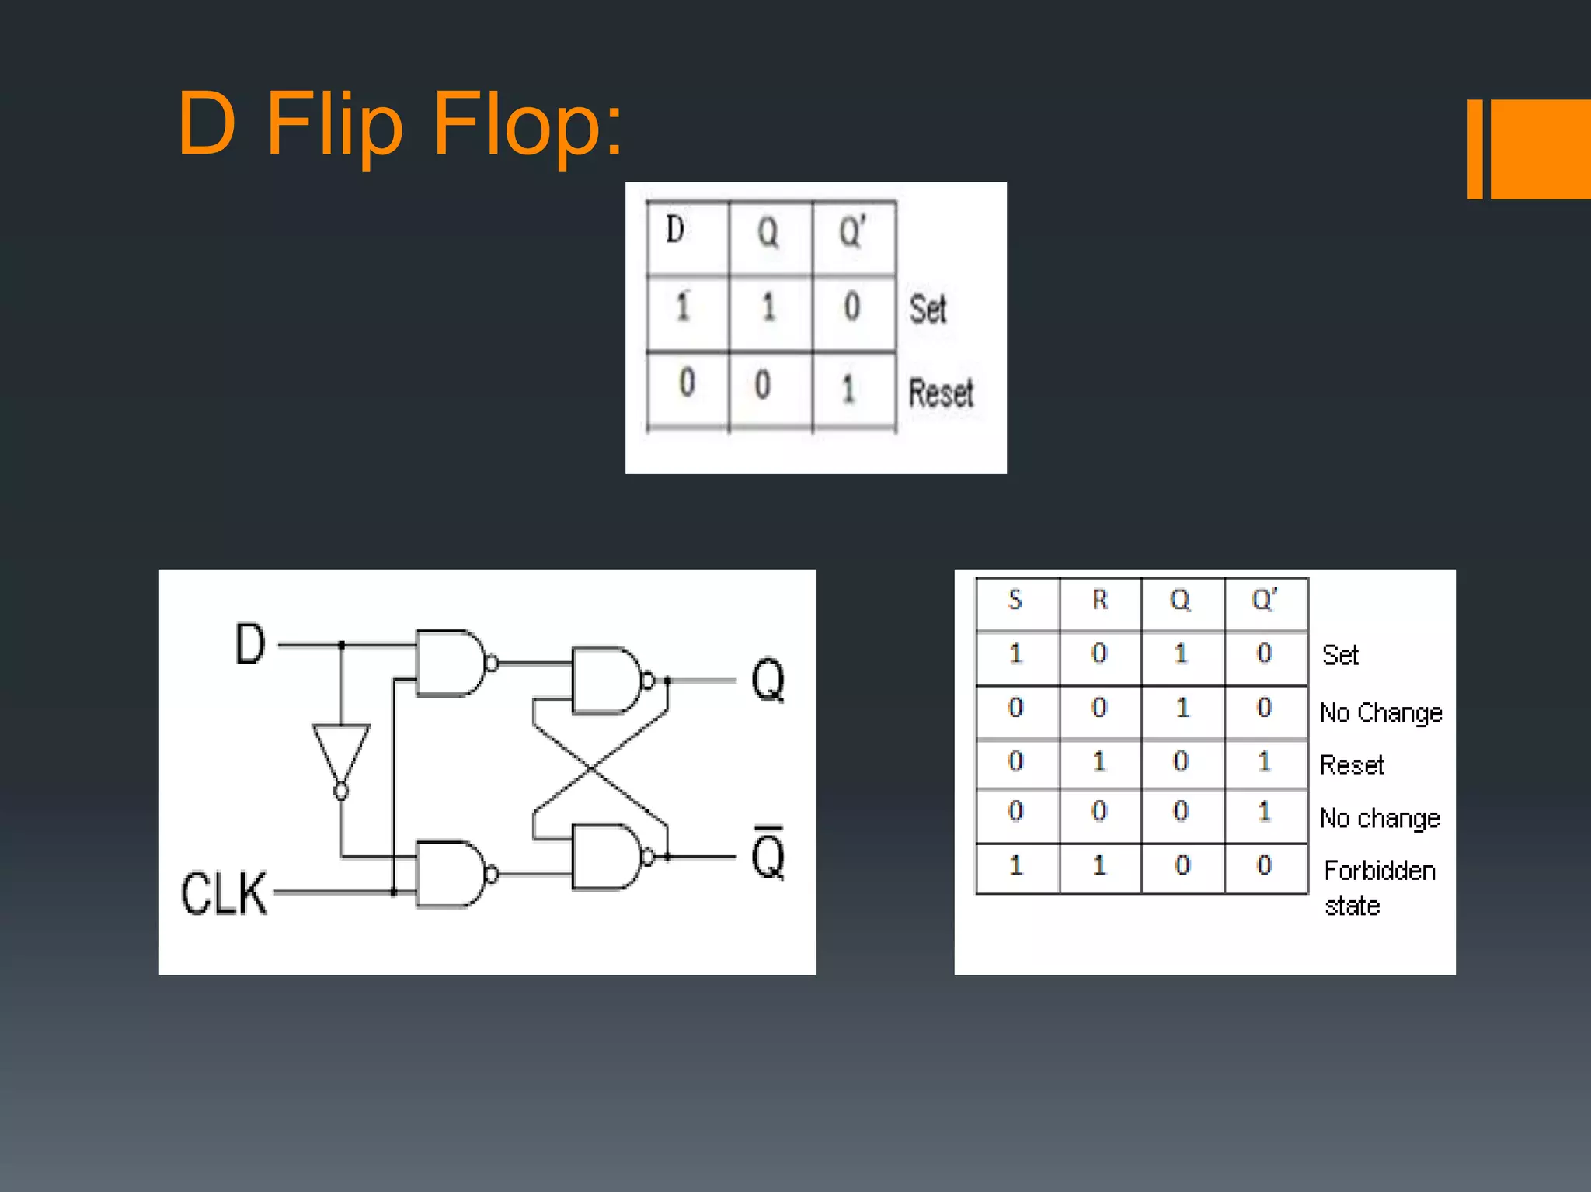

Slide 29
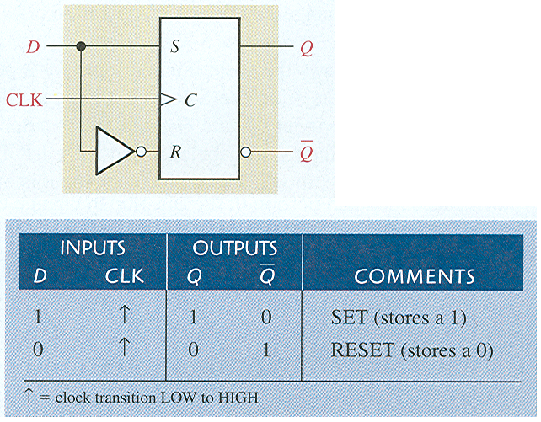
Edge-Triggered Flip-Flops
Edge-triggered D flip-flop
Waveforms

Slide 30
Flip-flops
The J-K flip-flop is more versatile than the D flip flop. In addition to the clock input, it has two inputs, labeled J and K. When both J and K = 1, the output changes states (toggles) on the active clock edge (in this case, the rising edge).

Slide 31
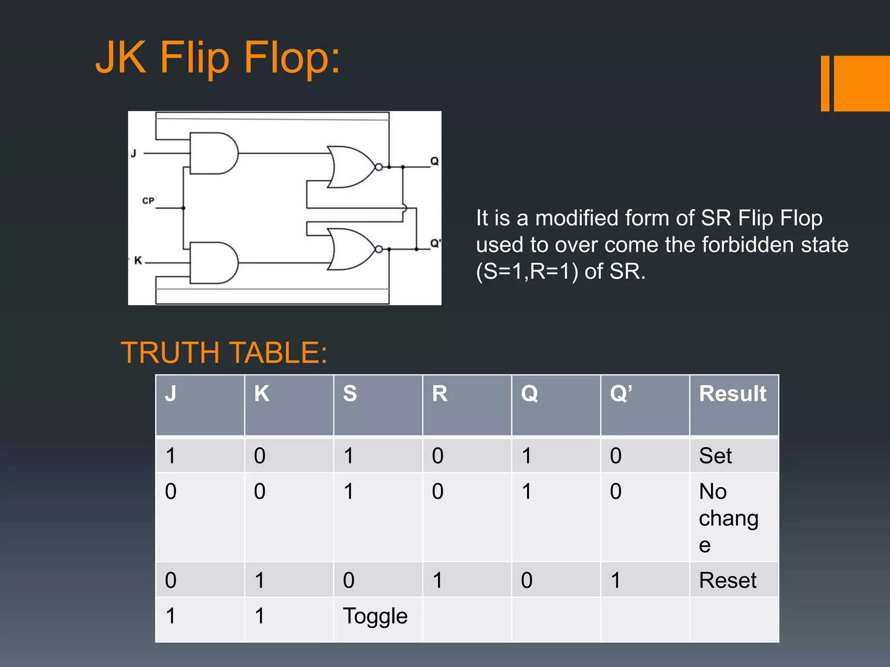

Slide 32
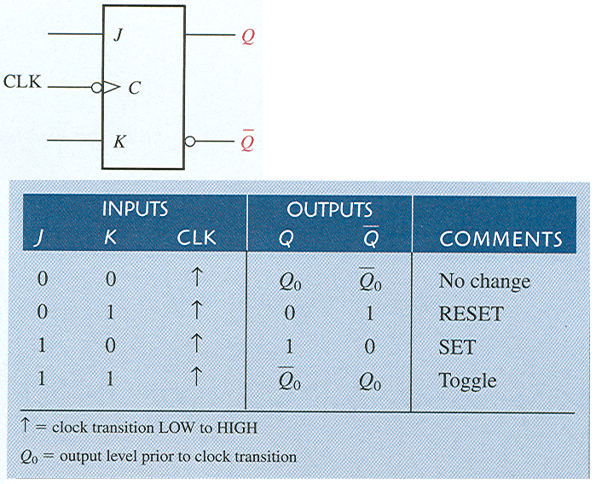
Edge-Triggered Flip-Flops
Edge-triggered J-K flip-flop
Waveforms

Slide 33
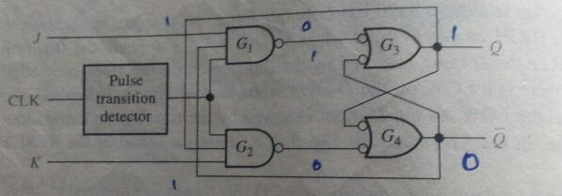

Slide 34
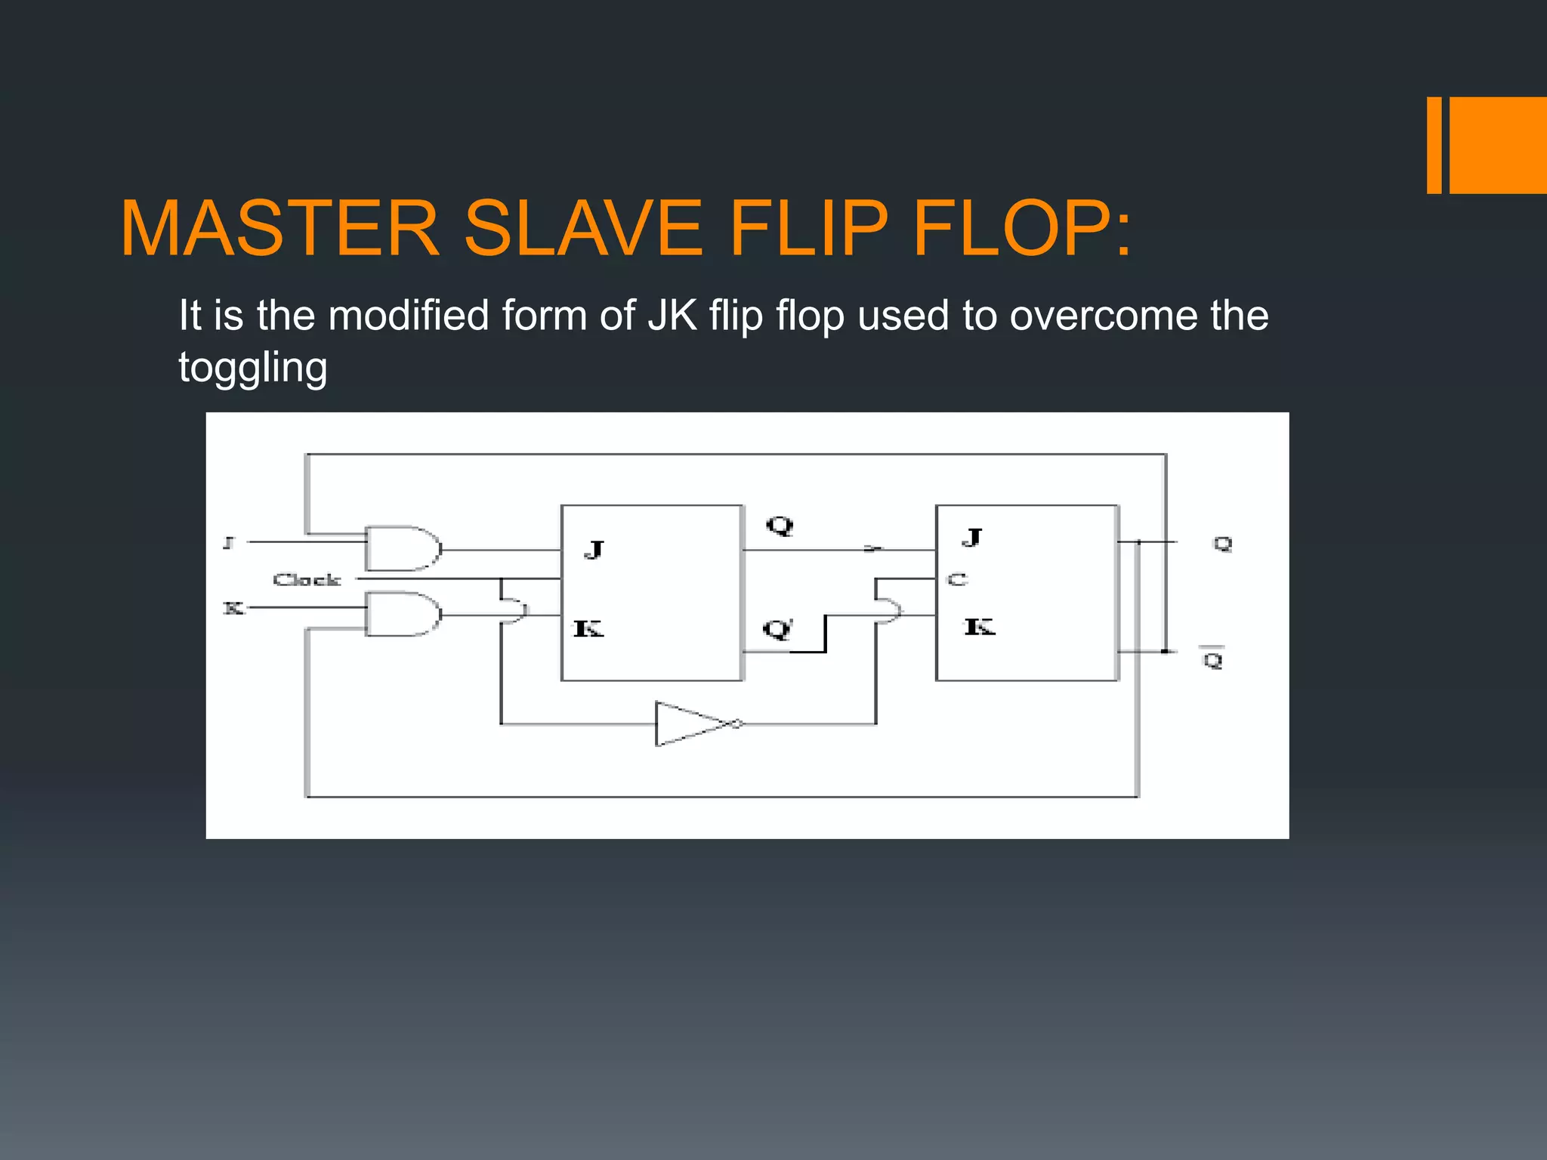

Slide 35
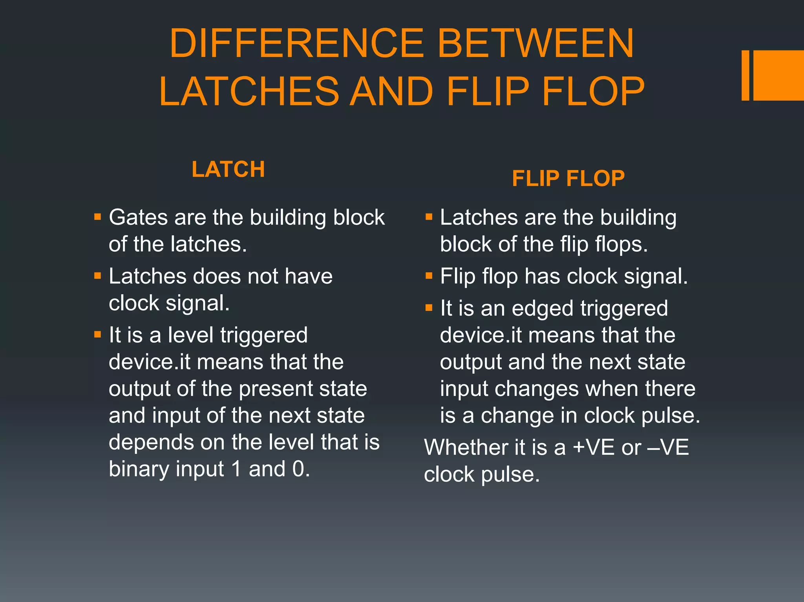

Slide 36
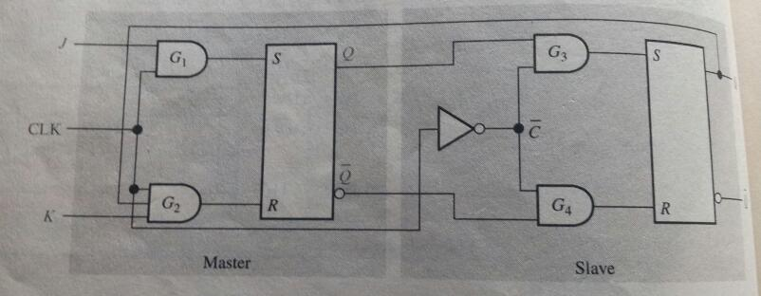
PULSE TRIGGERED FLIP FLOP

Slide 37
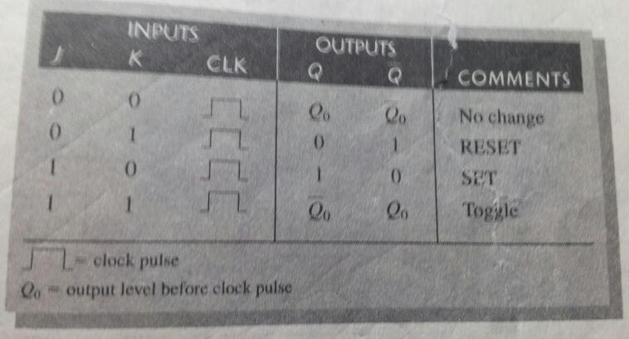

Slide 38


